Slide 1



Rehisk
AI
Overview

Slide 2
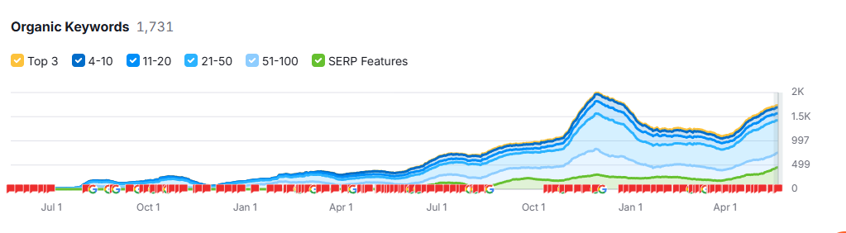
Keyword Overview

Slide 3
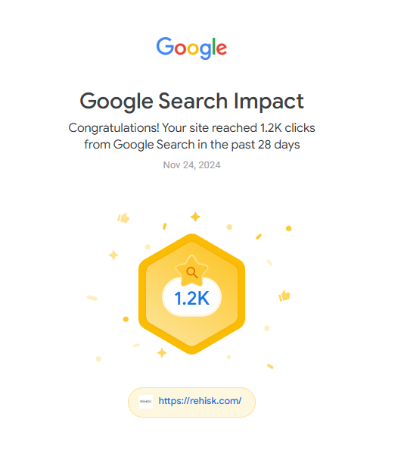
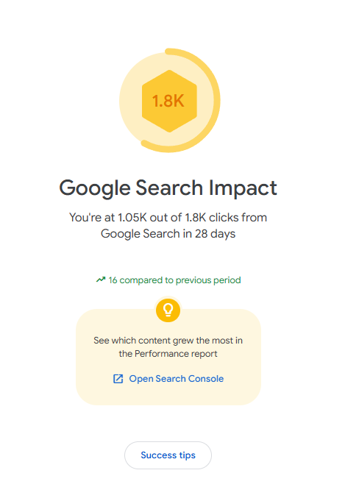
Search Console Data

Slide 4
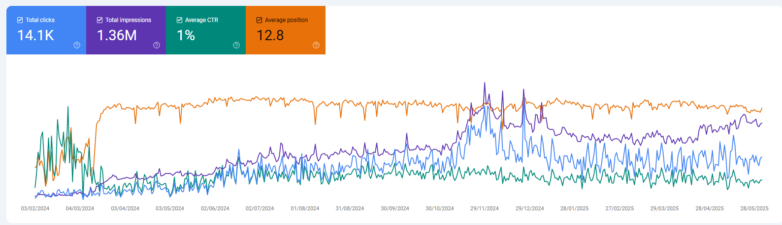
Search Console Data

Slide 5
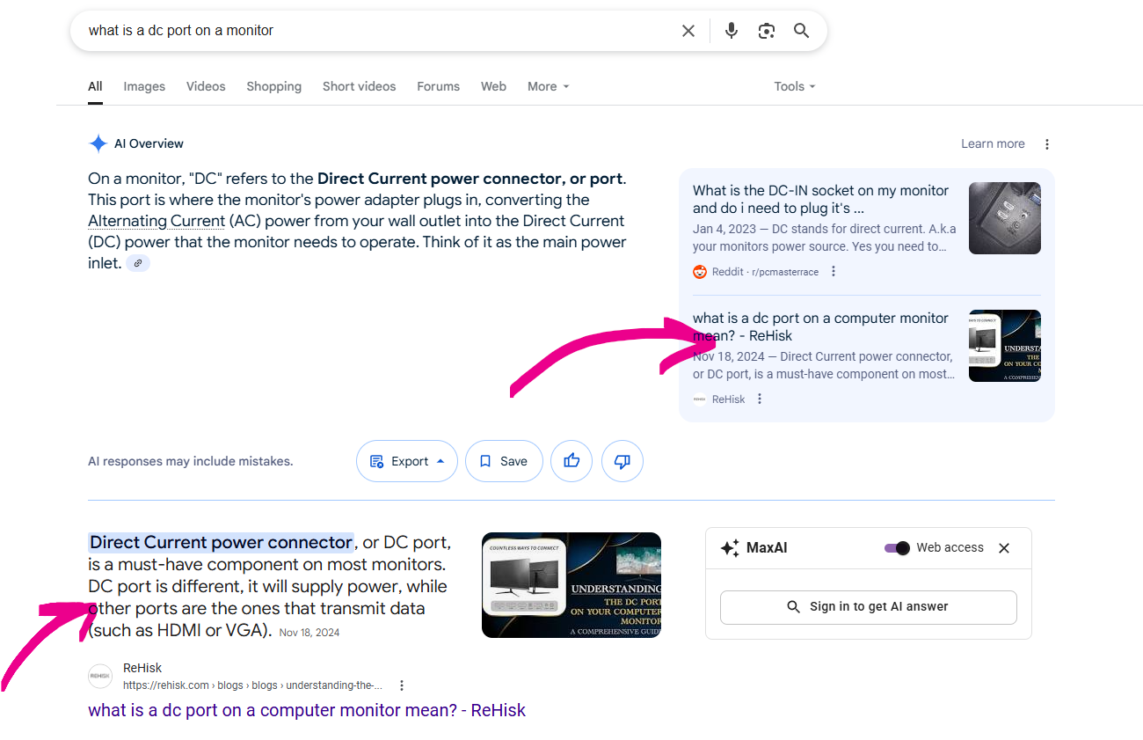

Blog/AI Results
This slide shows Some of the Blogs which are ranking on Top with AI Result Feature.

Slide 6
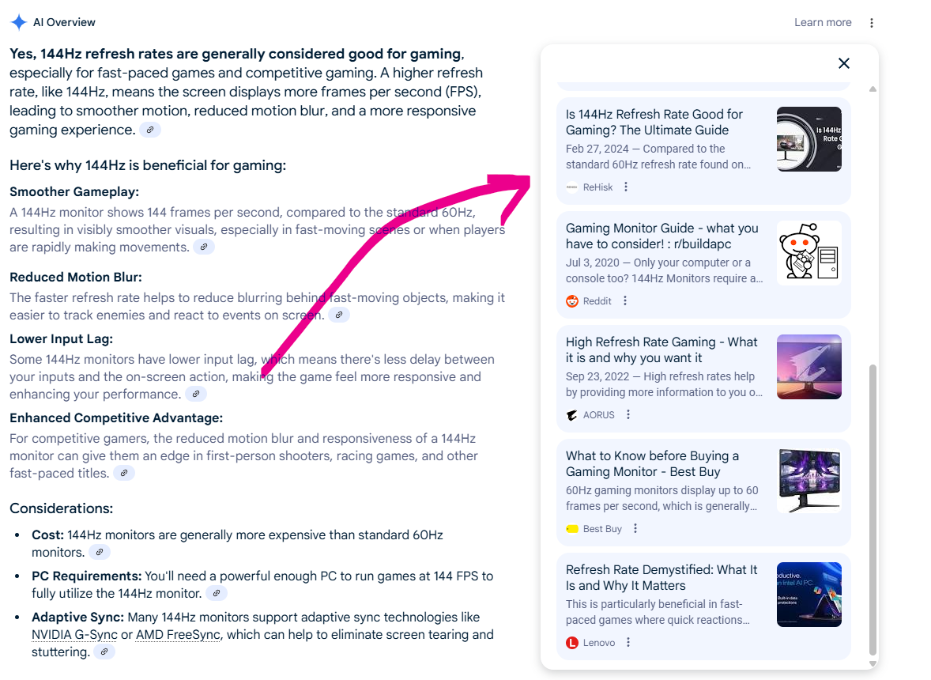
Blog/AI Results
This slide shows Some of the Blogs which are ranking on Top with AI Result Feature.

Slide 7
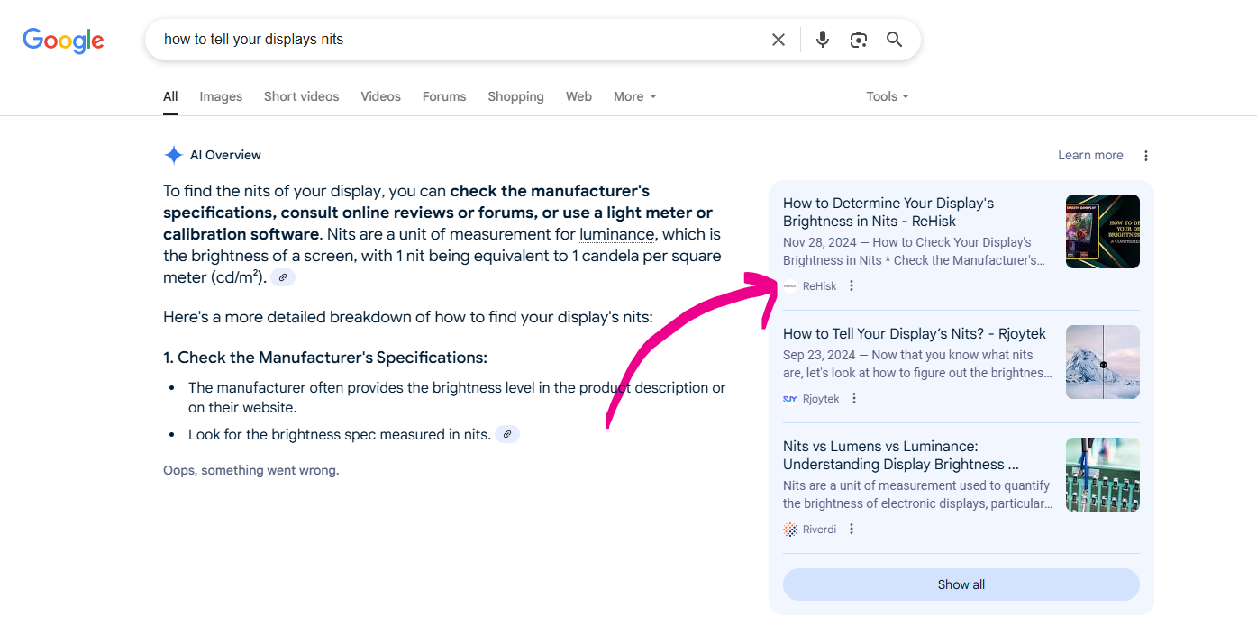
SERP Results
This slide shows Some of the Blogs which are appearing in Google SERP feature.

Slide 8
Thank You

